Slide 1



Exploring Gradient Descent
Team: Future AI Wizards

Slide 2

A Fun Dive into a Key Deep Learning Concept
Imagine you're playing a game where you're standing on a hill and your goal is to get to the bottom where a treasure chest is hidden. You can't see the path down because there are so many twists and turns, so you have to feel the ground to figure out which way goes downhill. How do you even begin to make your way down?

Slide 3

Step by Step to Treasure
Embarking on the Trail: Well, let’s begin! You’re at the top of the hill with a map in hand. What next?
Checking the Map: You look at your map (the slope of the function) to figure out which direction will take you closer to the treasure.
Taking Calculated Steps: With each clue, you take steps (update your guesses) toward the treasure, making sure each one counts!
Finding the X Marks the Spot: By following the map and updating your route, you reach 'X marks the spot', the optimal solution.
‎

Slide 4

So what is it?
In deep learning, gradient descent is like finding the best path down a mountain to minimize mistakes our computer program makes.

Slide 5

Setting the Speed with Learning Rate
Just Right Wins the Race: Finding the perfect speed (learning rate) is key. It's the sweet spot that gets you to the finish line efficiently without any crashes.
Gradient descent is like the brain behind many smart systems. It helps in making smart homes, creating games, and even in understanding our speech!
‎

Slide 6
Types of gradient descent
Gradient descent can be done in different ways:
Batch
Stochastic,
Mini-Batch.
Each has its way of taking 'steps' towards the best solution.

Slide 7
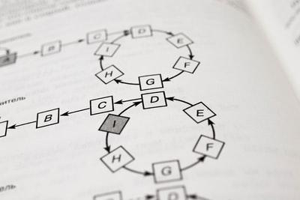
Your Map to More Knowledge
Books to Bury Yourself In:
1. Deep Learning' by Goodfellow, Bengio, and Courville for a thorough dive.
2. Machine Learning Yearning' by Andrew Ng to guide your strategy in learning.
‎

Slide 8

References
Gradient descent in machine learning: What & how does it work . . (2023, September 7). https://www.knowledgehut.com/blog/data-science/gradient-descent-in-machine-learning#what-is-gradient%E2%80%AFdescent-in-machine-learning?

